Slide 1
Macrosoft’s TriviaMaze
By: Andrey Melnikov, Alexander Staeheli, Isaiah Grant, Austin Johnston

Slide 2
Gameplay Basics
Backstory: Teleported to 2D world
You are in a giant maze
Goal is to get to the exit (back to 3D world)
Each room has doors
Each door has a Trivia Question
Answer right – door opens
Answer wrong – door locks
No path to exit – lose game
Notes:
Next: Austin - State Diagram of Game Flow

Slide 3
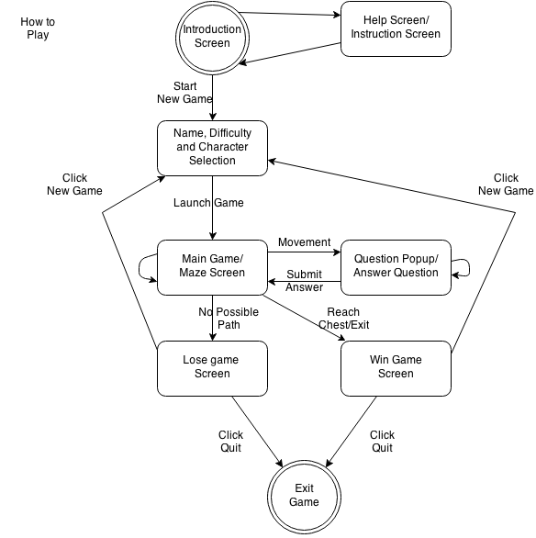
State
Notes:
Next: Isaiah – Class Diagram

Slide 4
UML – Class Diagram

Slide 5
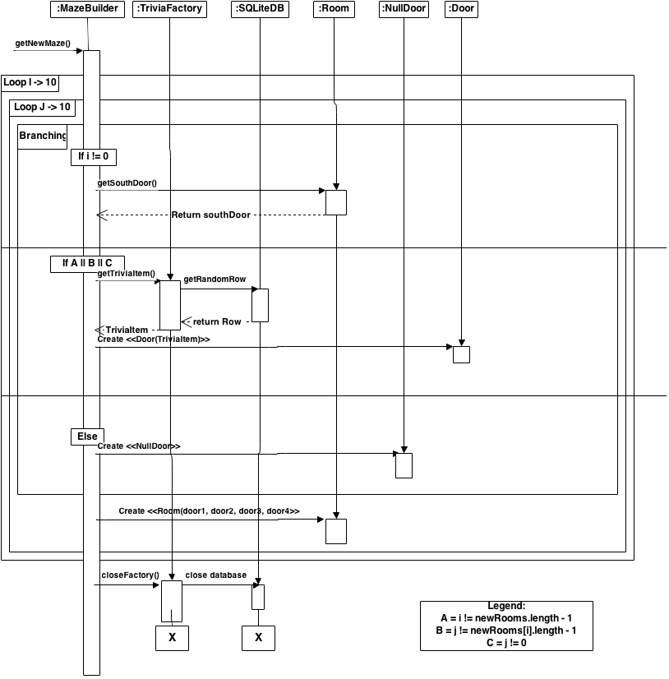
Sequence
Notes:
Next: Andrey - Demo of Game

Slide 6


Slide 7


